Slide 1


HR ANALYTICS CASE STUDY SUBMISSION
Group Name:
Prasoon Dayal
Nitin Srivastava
Satya Mishra

Slide 2
XYZ Company Requirement Summary
1. XYZ, employs, at any given point of time, around 4000 employees, but every year, around 15% of its employees leave the company and need to be replaced with the talent pool available in the job market. XYZ wants to cut down on the attrition rate.
XYZ’s Current thoughts on why attrition is bad:
Project delays leading to missing timelines hence loss of goodwill in front of consumers and partners.
Having to maintain a sizeable HR team for recruitment all the time.
New employees need to be trained to be job ready.
Approach
Understand the data
Merging of dataset's, Data cleaning, Data Manipulation
Analysing Variables
Segmented analysis, Dummy variable creation
Modelling
Model creation and Model validation

Slide 3
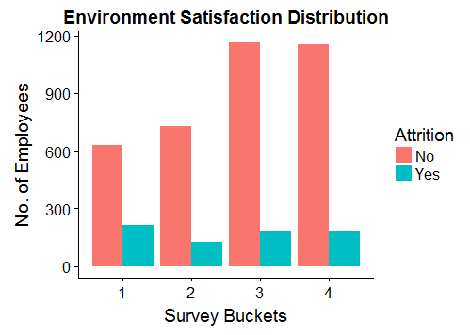
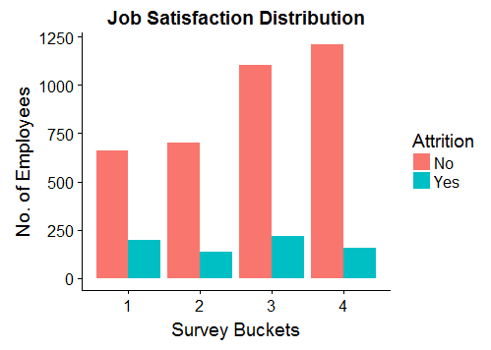
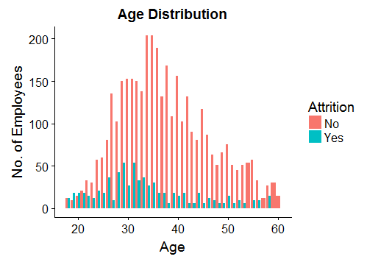
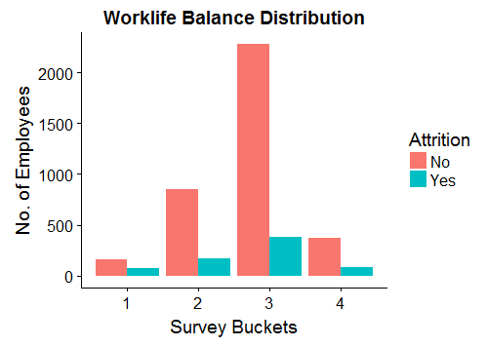
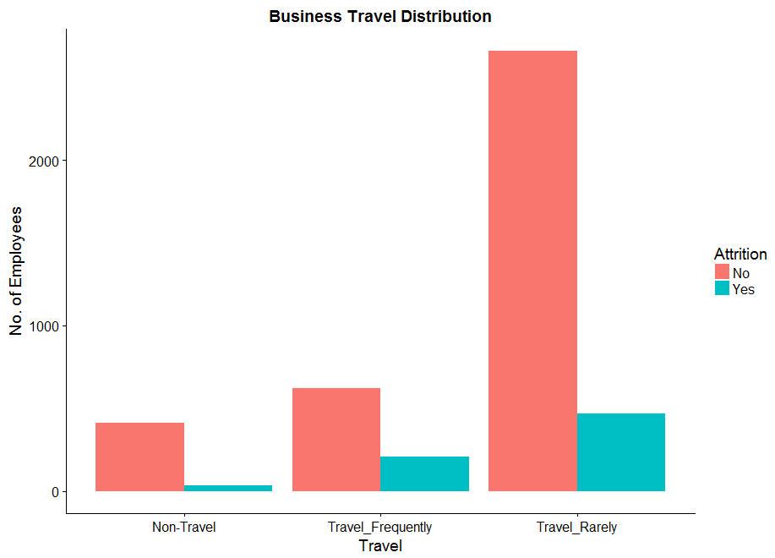
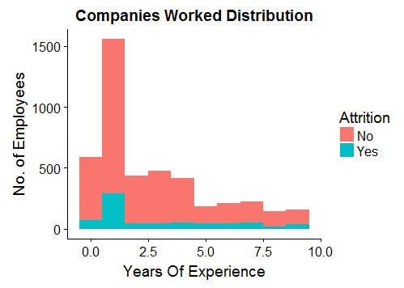
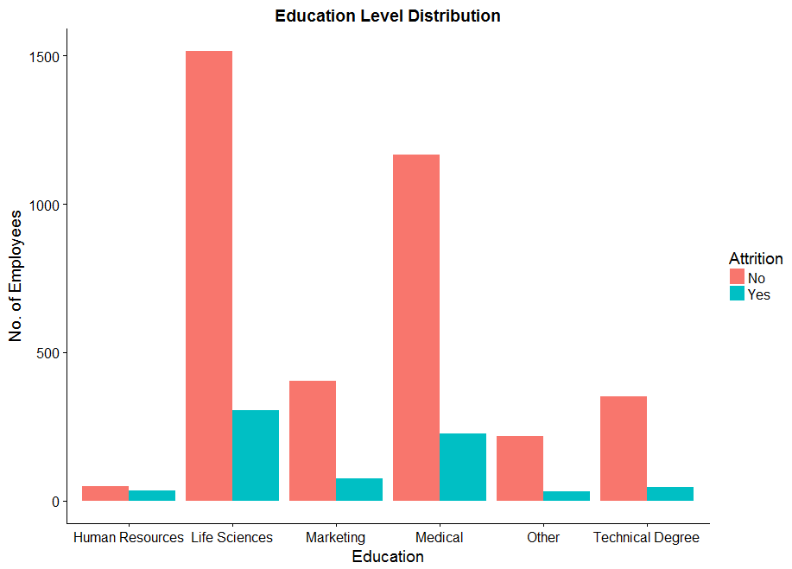
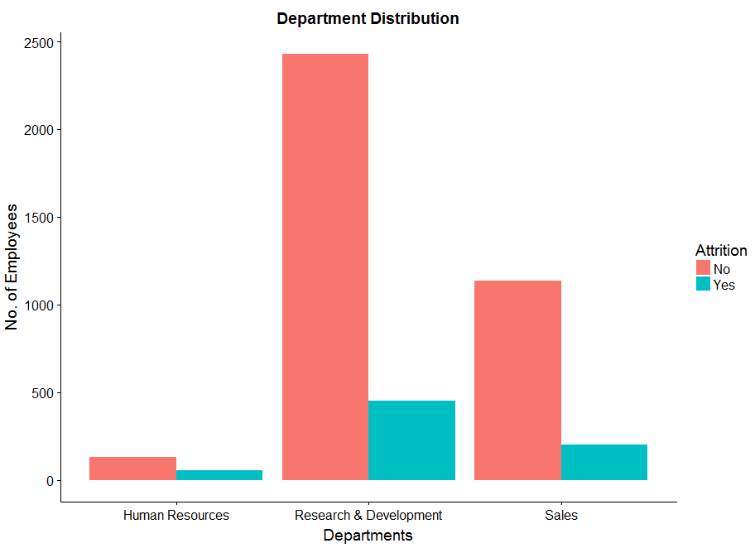
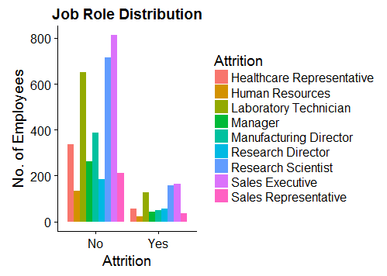
Univariate Analysis

Slide 4
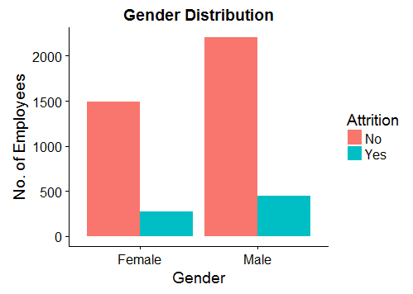
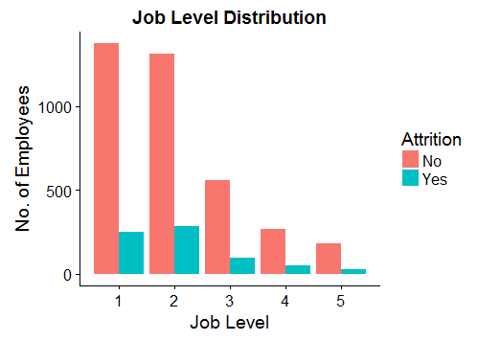
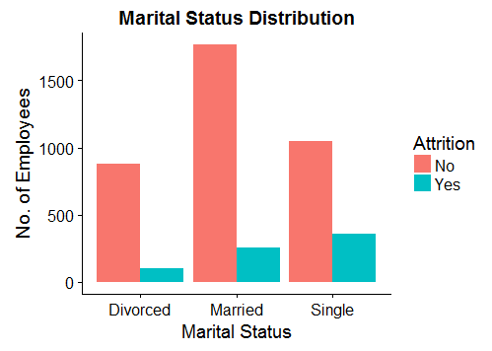
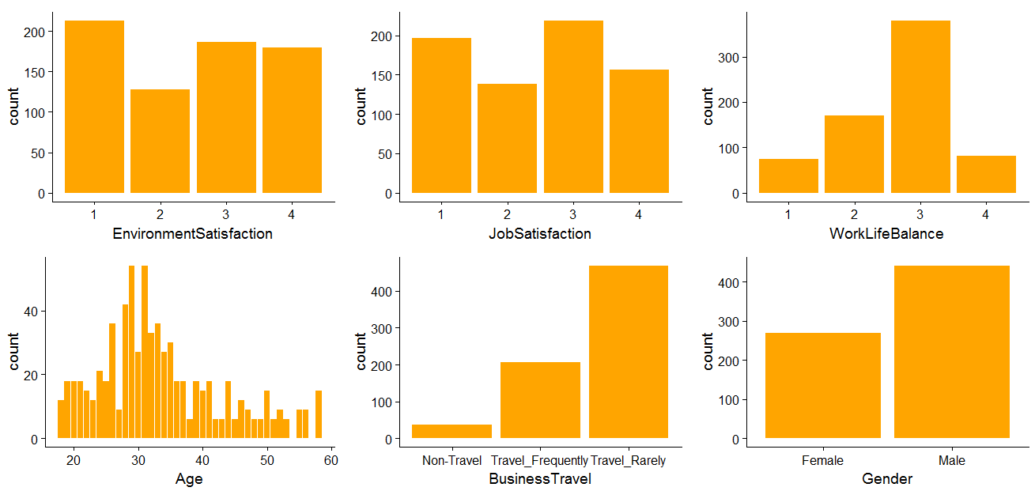
Univariate Analysis (continued)
While doing Univariate analysis of attrition over other variables we saw employees with marital status as “SINGLE” and the employees who gave a low rating in Environment Satisfaction have higher attrition rate.
Segmented Analysis (Where Attrition is “YES”)

Slide 5
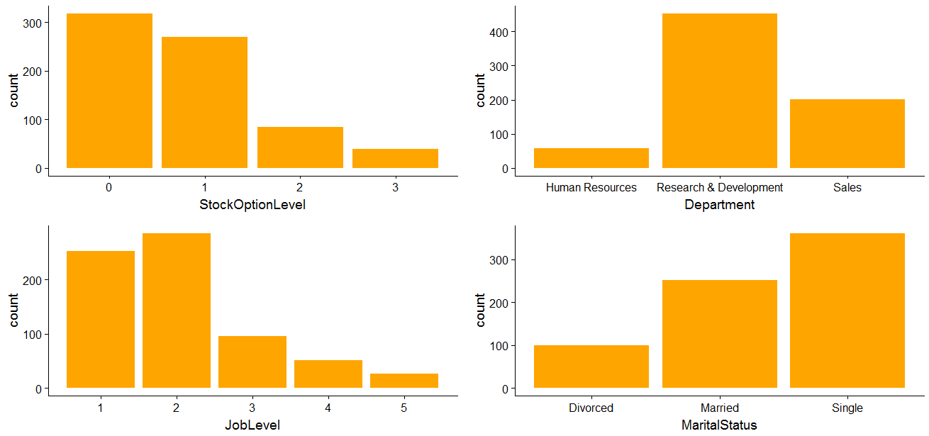
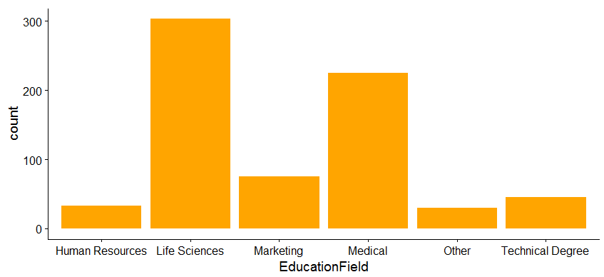
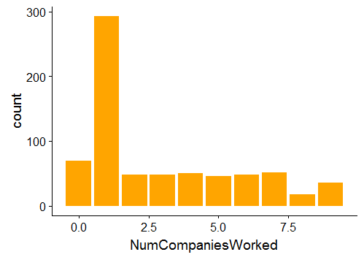
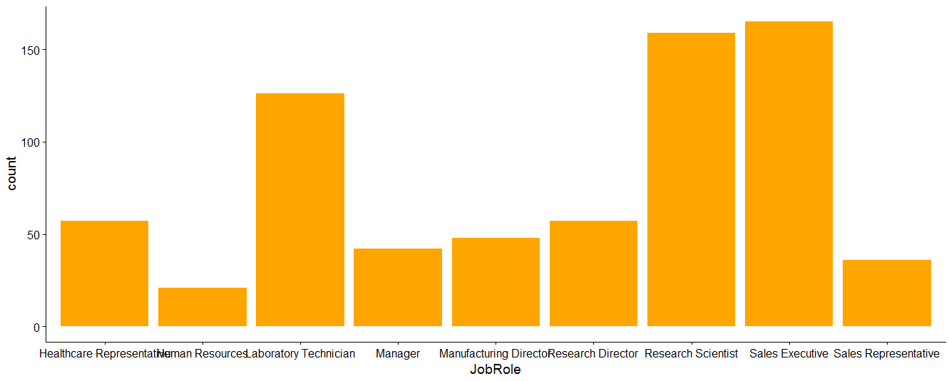
Segmented Analysis (Where Attrition is “YES”)
While doing segmented analysis of attrition (where attrition is YES) over other variables we do not see any of the variable having a major impact. The attrition across the variable’s tells the same story .

Slide 6
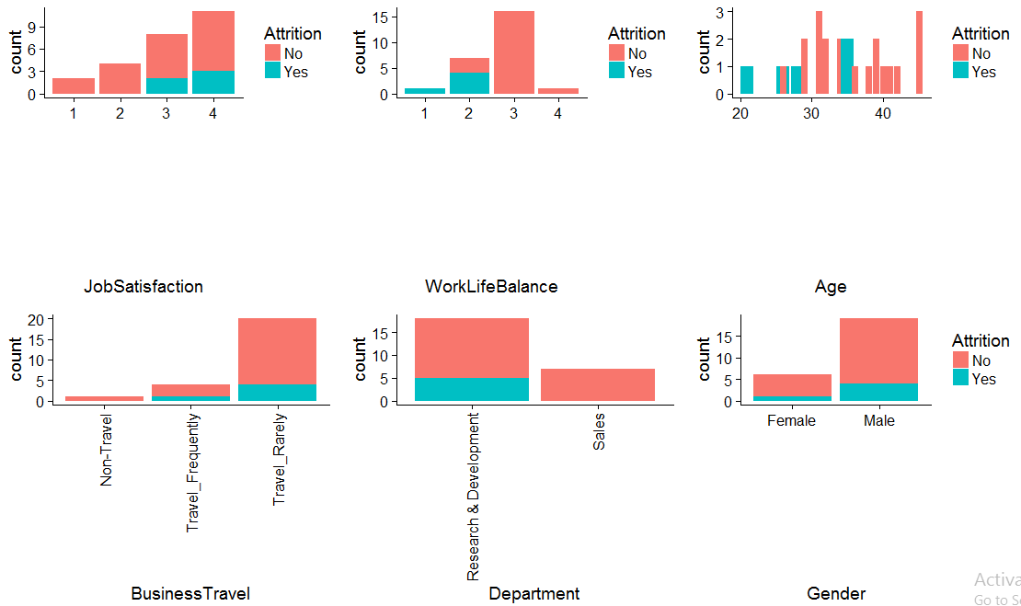
Summary Of Univariate Analysis
1.We looked into the different variable that compromise of both categorical and continuous types, we saw employees with marital status as “SINGLE” and the employees who gave a low rating in Environment Satisfaction have higher attrition rate.
2.There are no such variable that single handedly influence the attrition rate.
3.We understand that in XYZ company most of the employees work as laboratory technician and sales executive.
4.The age variable has normally distributed curve with most of the attrition happening in the age group of 25 to 35.
5.Most of the employees work in the research and development department and come from life science background.
6.The trends that follow for overall data is also same for segmented analysis on attrition as YES.
Distribution of NA values for different variables on Attrition

Slide 7
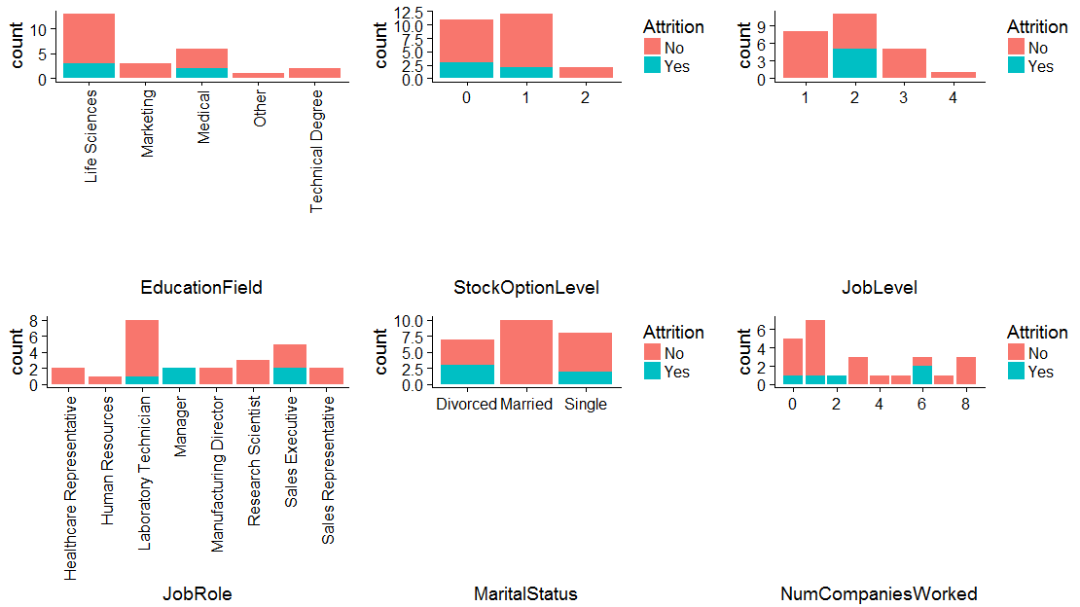
Distribution of NA values for different variables on Attrition
We see that Environment Satisfaction has 25 NA’s. In the same way JobSatisfaction , WorkLifeBalance, NumCompaniesWorked & TotalWorkingYears have 20, 38, 19, 9 NA's respectively (graphs included in R Code file).
In order to avoid bias, we selected WOE analysis for EnvironmentSatisfaction, JobSatisfaction , WorkLifeBalance, NumCompaniesWorked and replaced all values with respective WOE values including NA. For TotalWorkingYears , observation with NA values were removed.

Slide 8
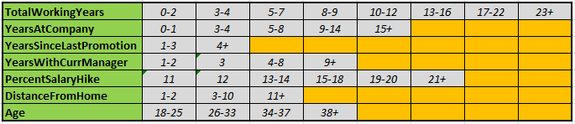
Data Manipulation
Binning and Treatment of outlier values
For Monthly Income replaced salary greater than 137756.0 with 137756.0.
Binning of continuous variables shown in below table helped to treat them as categorical variables.
Bins were creates as below:
Dummy variable creation
After WOE analysis, dummy variables were created for all categorical and continuous variables. These included
Education, Environment Satisfaction, Job Satisfaction, Work Life Balance, Business Travel, Department, Education Field, Gender, Job Level, Job Role, Marital Status, Number Companies Worked, Stock Option Level, Training Times Last Year, Job Involvement, Performance Rating, Percent Salary Hike, Total Working Years, Years At Company, Years Since Last Promotion, Years With Current Manager, Distance From Home, Age & Attrition.
Note – EmployeeId and Attrition was skipped during this analysis.
Attrition values were converted to numeric 1 and 0, with 1 resembling’ Yes’
Scaling variables
The only variable that was scaled is Monthly Income

Slide 9
Modelling Stage
Model creation activity
We used logistic regression to predict the classification of attrition as YES or NO.
The final data set that was used for model building activity had 82 variables.
70% of the dataset was used to train the classification model and the rest of 30% was kept for testing phase
Step AIC function was used to eliminate non significant variables at one go.
A total of 30 models were created to arrive at the final model to be used.
The removal of variables was based on High VIF and insignificance value of (p>0.05)
Inference
The final model showed below factors affecting attrition of an employee:
# EnvironmentSatisfaction 'Low'
# JobSatisfaction 'Low'
# WorkLifeBalance 'Low'
# BusinessTravel Frequently
# JobLevel at scale 2
# JobRole Manufacturing Director
# Jobrole Research Director
# Marital Status Single

Slide 10
Modelling Stage
Inference contd.
# Those who have not worked in any company before
# No. of trainings conducted for employee last year - 6
# ‘High‘ level of involvement in job
# Years spent by employee at company in range of 5-8
# Years spent by employee with current manager is in range of 1-2
# Age is 38 or above
# Actual Working Hours is more than 8.5 hours.
Model validation activity
We have used the predict function to get the predictions.
We have mentioned the type as response as that will give us the probability values.
The probability obtained has a range from 0.5% to 90%
We choose the probability threshold as 0.50 to do the prediction and saw the accuracy to be around 85%, sensitivity to be around 19% and specificity to be around 97%.
As per our requirement we want the sensitivity to give us a much higher level that 19%

Slide 11
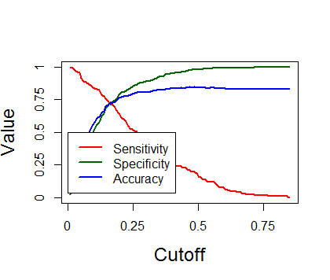
Modelling Validation(Continued)
Getting the optimum probability threshold
An user defined function was created to plot a line graph with the three parameters namely Accuracy, Sensitivity & Specificity.
The optimal probability threshold came out to 0.18580 for the best prediction
The final score that was achieved for all the three parameters are: -
Accuracy – 74.03
Specificity - 73.66%
Sensitivity – 74.10%

Slide 12
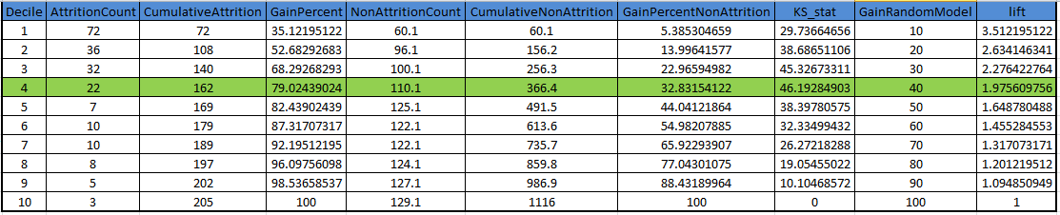
Modelling Validation (Continued)
Additional Evaluation Metrics
We considered below statistics for our model evaluation in addition to sensitivity, specificity and accuracy.
KS-Statistic
Gain – Lift Analysis and Chart
ROC Curve
Our analysis presented below KS-stats table. (refer R-code)
Inference
KS-Stat table showed that KS-statistic was 46.19 in 4th decile.
This implies that our model can help us in identifying 79% of employees who will leave, by targeting 40% of workforce.

Slide 13
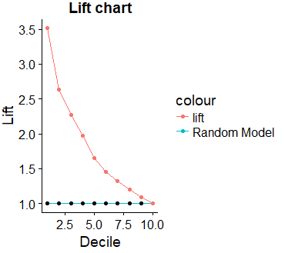
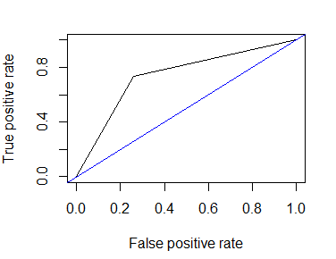
Modelling Validation (Continued)
Lift Chart
ROC Curve
Inference
Lift Chart and ROC Curve shows that our model is able to distinguish between employees who will leave and those who will not.

